Slide 1
Visualizing Data using t-SNE
Papers by Laurens van der maaten and geoffrey Hinton

Slide 2
Past Methods
Visualize only a few variables at a time
Weak because only a few points can be compared
Not feasible with modern datasets
Map high-dimensional data to 2D or 3D to show in a scatterplot
X is the high-dimensional vector, and Y is the low dimensional vector
Old methods (like PCA) rely on keeping dissimilar points far apart
Weak because modern high-dimensional data is usually nonlinear
More important to keep similar points close together
SNE (Stochastic Neighbor Embedding) accomplishes this
Struggle with representing data though
Forms basis for t-SNE

Slide 3
t-SNE (t-Distributed Stochastic Neighbor Embedding) Overview
1. Convert distance between points in X to probability distribution
Close points have high probability, distant points have low probability
2. Create another matrix Y in lower dimension with similar probability distribution
3. Minimize the difference between the matrices by minimizing the Kullbach-Leibler Divergence
This low dimensional matrix can now be represented in a scatterplot, and its statistical properties are similar to the high-dimensional dataset

Slide 4

Computing Pairwise Probabilities in High Dimensional Set
The similarity of point x_{i} to x_{j} is given by the conditional probability p_{j|i}
This is the likelihood that x_{i} would pick x_{j} as its neighbor under a Gaussian centered at x_{i}
Therefore, close points have a high p, while distant points have a low p
$p_{j|i}$= $\frac{exp⁡(−\frac{{\left\|x_{i}−x_{j}\right\|}^{2}}{2σ_{i}^{2}})}{\sum_{k ≠i}{exp⁡(−\frac{{\left\|x_{i}−x_{k}\right\|}^{2}}{2σ_{i}^{2}})}}$ ,
x_{i} is chosen point and x_{j} are neighboring points in the Gaussian
$σ$ can vary by point, and is related to the perplexity value supplied by user
Basically, use high perplexity points with lots of neighbors and low perplexity with points with few neighbors (usually range between 5 and 50) – allows us to use a fixed number of points in distribution with different Gaussians to account for varying densities
Dividing by denominator normalizes the data

Slide 5

Computing Pairwise Probabilities in High Dimensional Set Continued
Finally, compute the actual probability for each point as an average between the conditional probabilities
$p_{ij}= \frac{p_{j|i}+p_{i|j}}{2n}$, where n is the low dimension (usually 2)
We now have the probability for each pair of points in the high dimensional space

Slide 6

Computing Pairwise Probabilities in Low Dimensional Set
Now, we can compute the probabilities in the low dimensional space
This uses a Student t-distribution (df = 1) instead of Gaussian – allows for distances in this map to be amplified to prevent crowding of data points in center of plot
Also computationally faster (no exponentials involved)
$q_{ij}= \frac{{(1+{\left\|y_{i}−y_{j}\right\|}^{2})}^{−1}}{\sum_{k ≠l}{{(1+{\left\|y_{k}−y_{l}\right\|}^{2})}^{−1}}}$
y_{i} is chosen point and y_{j} are neighboring points
Dividing by denominator normalizes the data

Slide 7

Minimize the Difference between the Probability Distributions
So now we have the probability distributions for the high and low dimensional datasets
We want to minimize their differences (the cost function)
Do this by minimizing Kullbach-Leibler Divergence (think of as a ratio between the two that helps preserves local structure by heavily penalizing similar points modeled far apart)
$C=KL\left(P∥Q\right)= \sum_{i}{\sum_{j}{p_{ij }log\frac{p_{ij}}{q_{ij}}}}$
So to minimize, we’ll take the gradient and perform gradient descent
Given by $\frac{δC}{δy_{i}}$ = $4\sum_{j}{( p_{ij}−q_{ij}) }{(1+{\left\|y_{i}−y_{j}\right\|}^{2})}^{−1}(y_{i}−y_{j})$
First two terms measure ”compression”— if q models p perfectly, becomes 0
The sum adds up all these forces exerted by other points and yields the resultant force to minimize the Kullbach-Leibler Divergence

Slide 8
Quick Timeout
So now we’re minimizing the differences between maps to get a faithful low-dimensional representation of the data
That last step with minimizing the Kullbach-Leibler Divergence was very expensive though
Had to compute resultant force based on interaction between each point and every other point in the map
I.E., (n points) x (n-1 other points) yields an O(n²) operation
Completely infeasible with big data sets
Can we improve upon this to get a more reasonable time complexity?

Slide 9

Enter Barnes-Hut Approximation
Instead of computing the gradient for each pair of points, use approximations for groups of points whose differences are negligible
Built using quadtree until each point has its own cell
Each cell stores center of mass of children along with the number of children it has
This center of mass can be used as a summary value for all of its children, allowing whole subtrees to be pruned and improving computation times drastically
To determine if a cell can be used as a summary, compute
$\frac{r_{cell}}{{\left\|y_{i}−y_{cell}\right\|}^{2}}$ < $θ$
$θ$ is provided by user (low value gives more precise results, but slows time; value of 0 gives exact value)
$r_{cell}$ is length of diagonal of cell
$y_{cell}$ is center of mass of cell
This improves the time complexity to O(nlogn)—much better

Slide 10
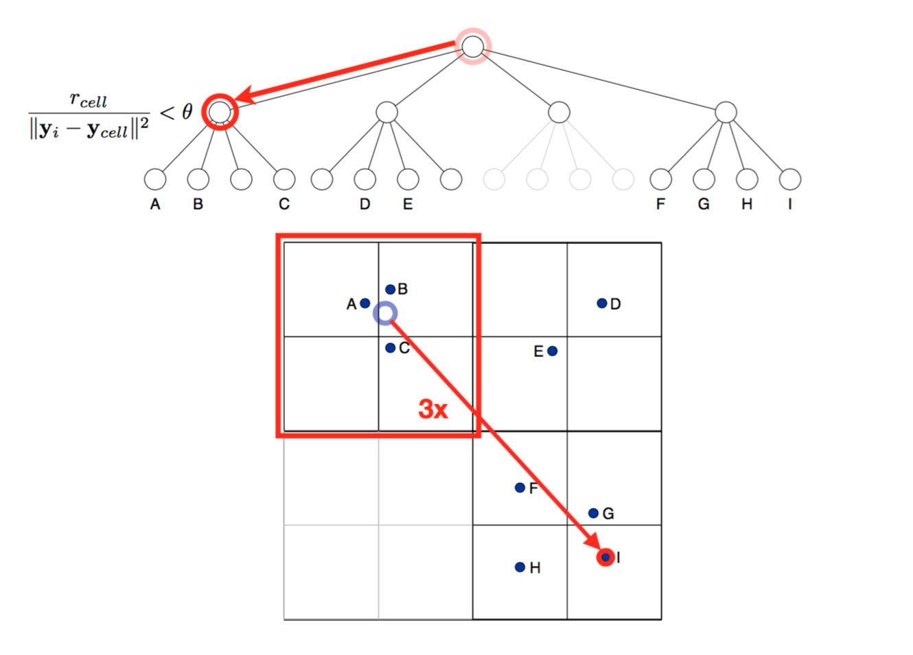

Slide 11
General Remarks
Useful for inspection, not so much for classification
Default algorithm assumes static dataset
Possible weaknesses include:
Only works well when reducing to 2 or 3 dimensions (not a problem for us)
Struggles with data with high intrinsic dimensionality
Error bounds are unbounded for the gradient (okay—since gradient is non-convex function, the gradient descent will converge to a minimum)

Slide 12
How are we using t-SNE right now?
Walk through code

Slide 13
Where to from here
Two large branches from here
Allow for continuous updating of visualization
That is, don’t rerun algorithm on entire dataset when new data is added, just fit new data into existing structure
Allow for human interaction
Perhaps allow user to group data to help speed up process
Users could also classify clusters

